Slide 1
Arduino
Programming Things

Slide 2
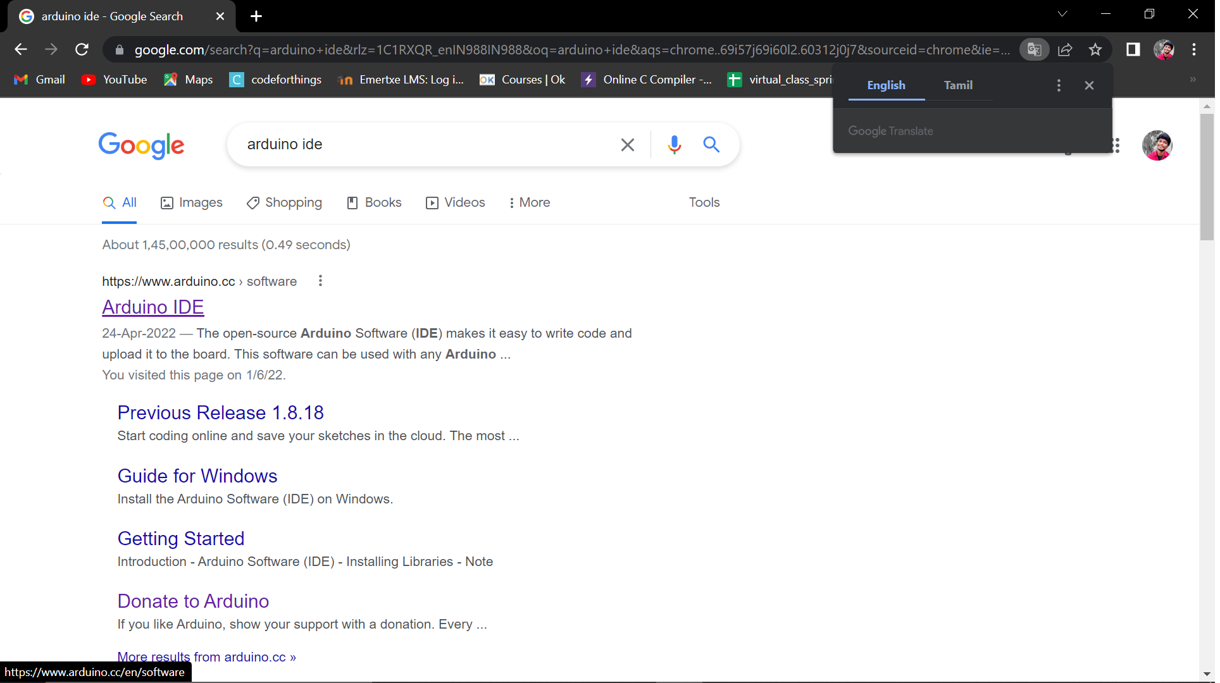
Arduino
Search for arduino ide on browser
Open the first link
Arduino ide

Slide 3
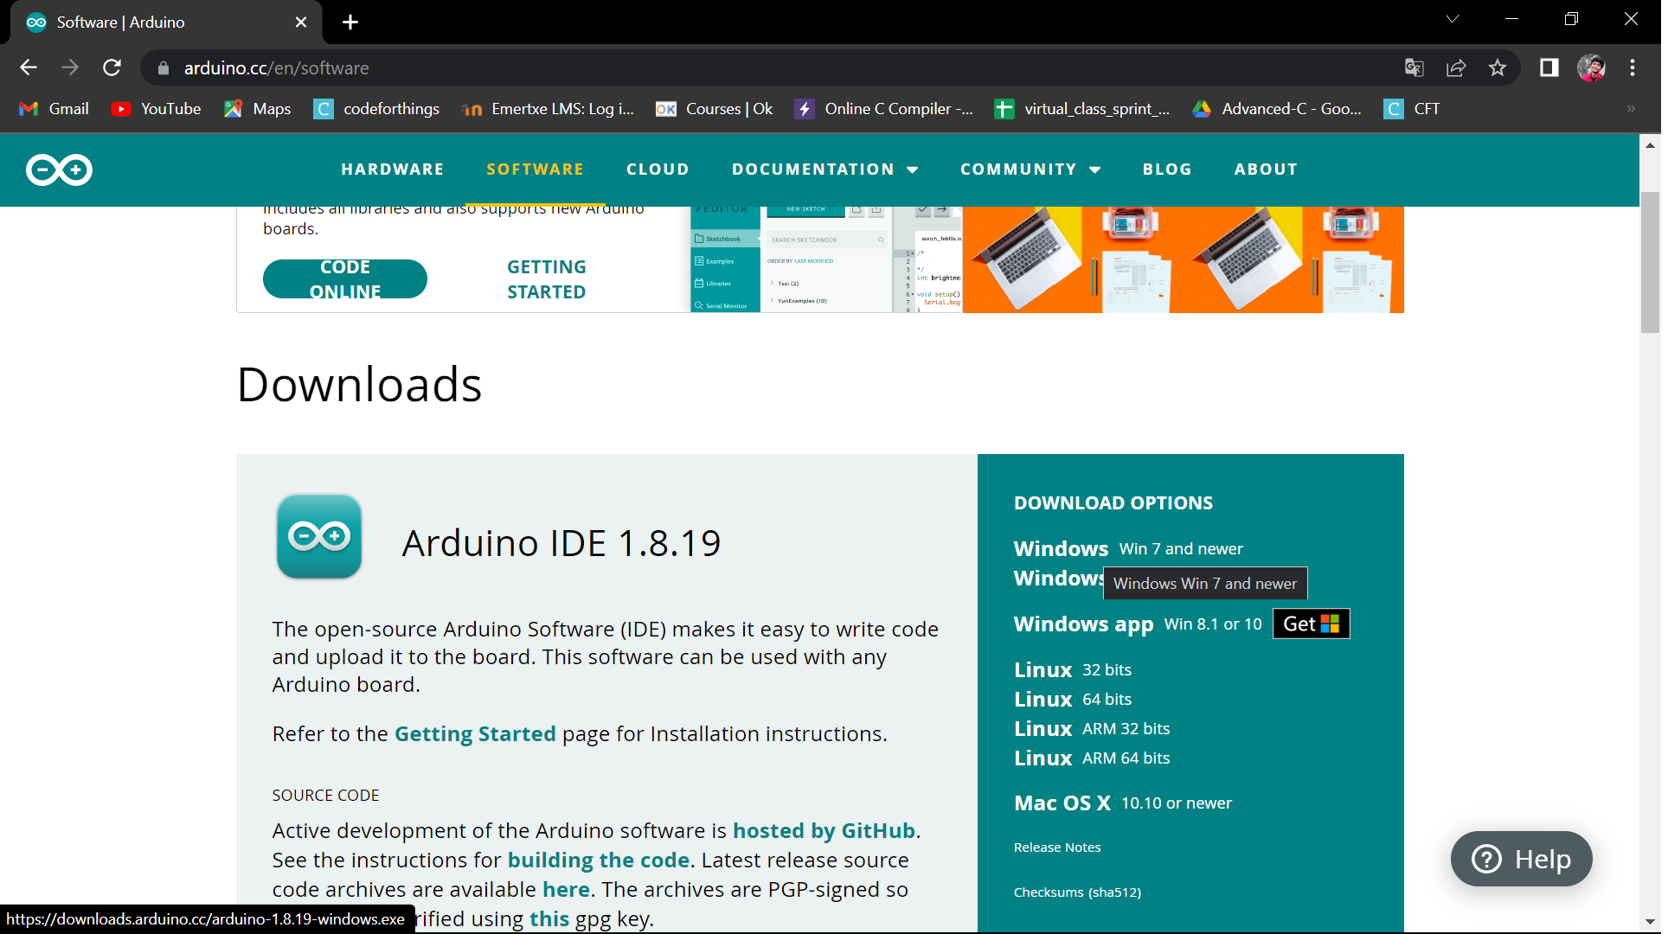
Arduino
Search for arduino ide on browser
Select Software
Select download option
based on the OS

Slide 4

Arduino
Click on the download button
Just Download

Slide 5
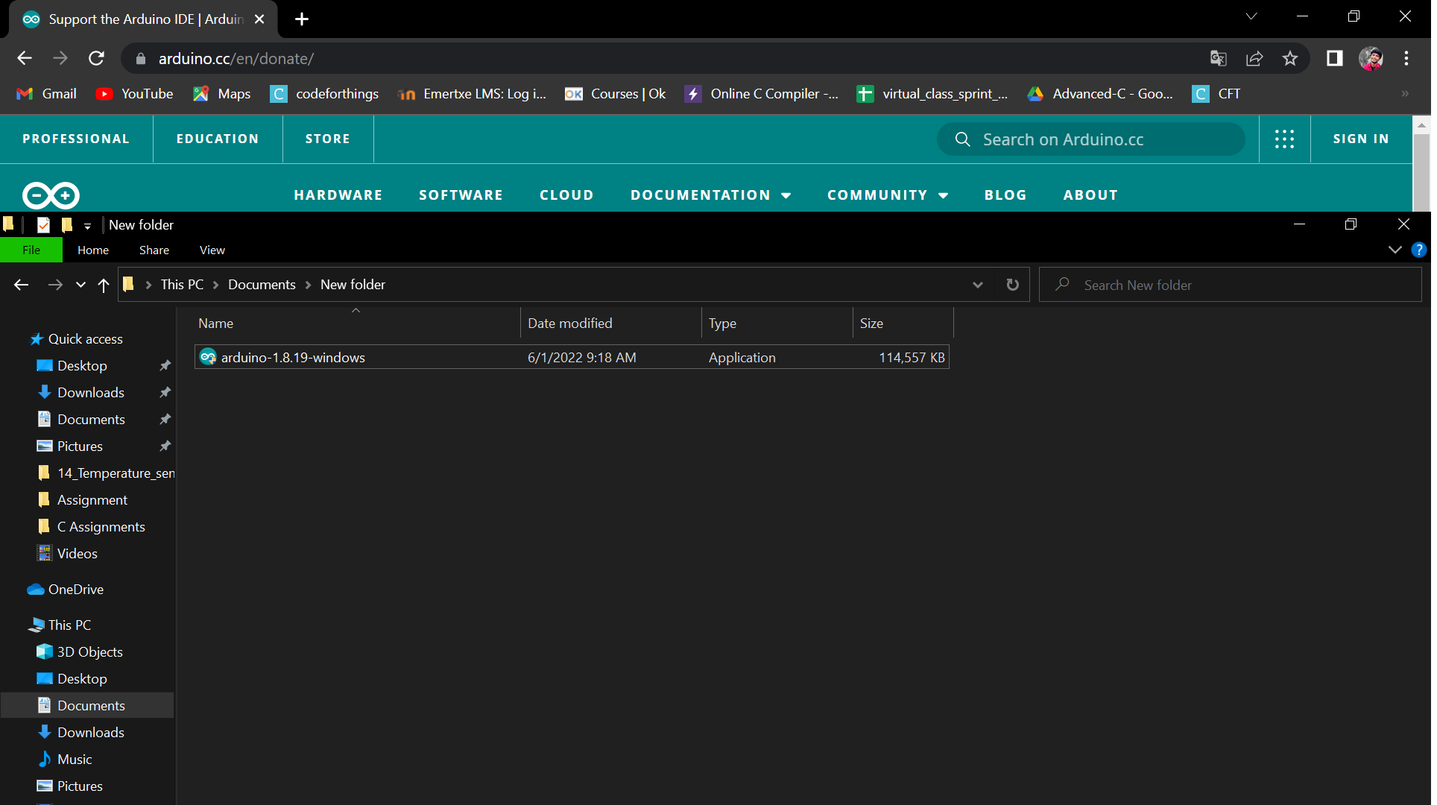
Arduino
Go to downloads
Select the downloaded files
Double click on the downloaded package to install the arduino Ide

Slide 6
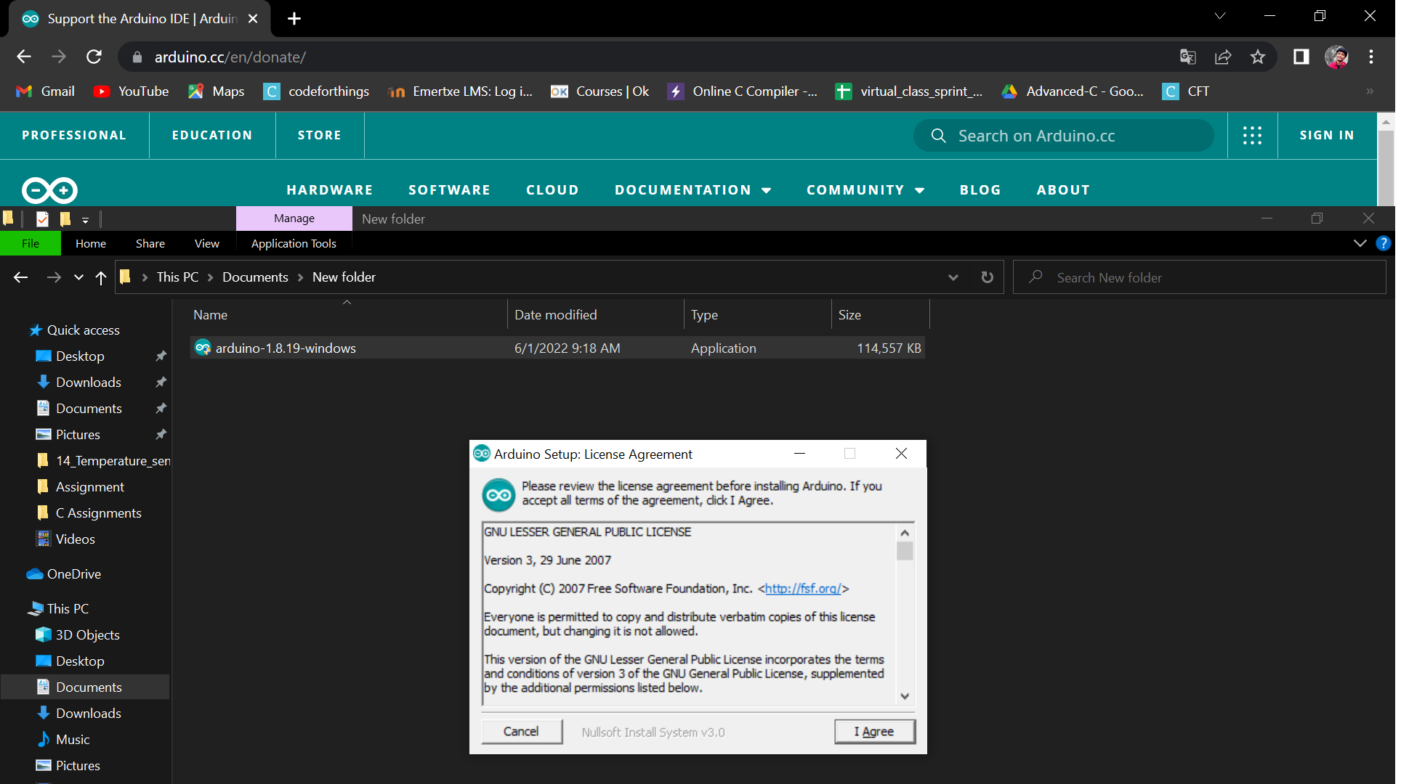
Arduino
Select I agree and continue

Slide 7
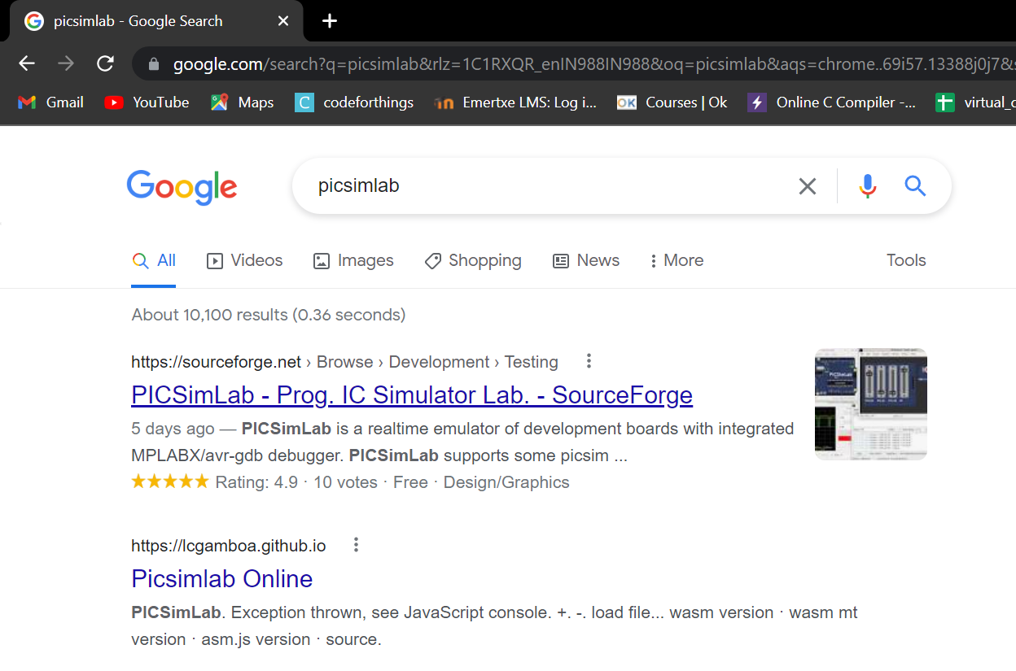
Arduino
Picsimlab installation
Search for picsimlab on google
Click on first link to download to the picsimlab tool

Slide 8
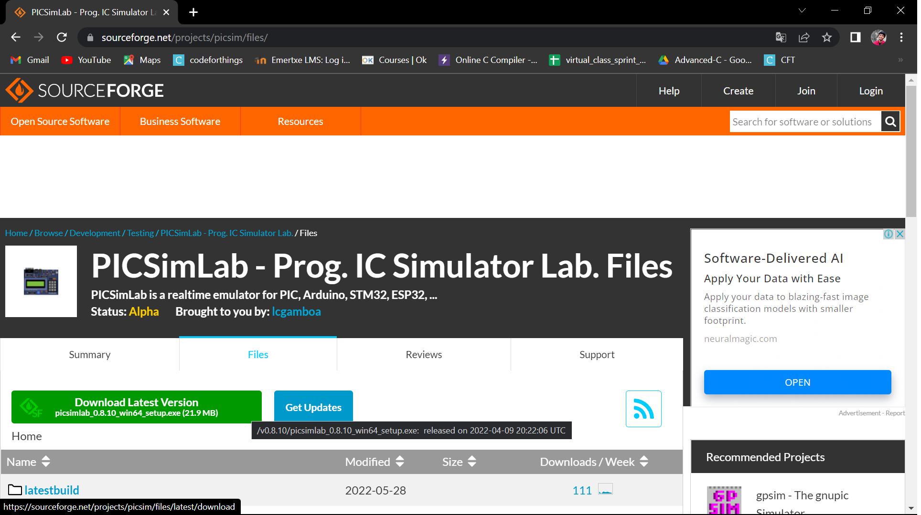
Arduino
Picsimlab installation
Click on Download the latest version
Download the
latest version

Slide 9
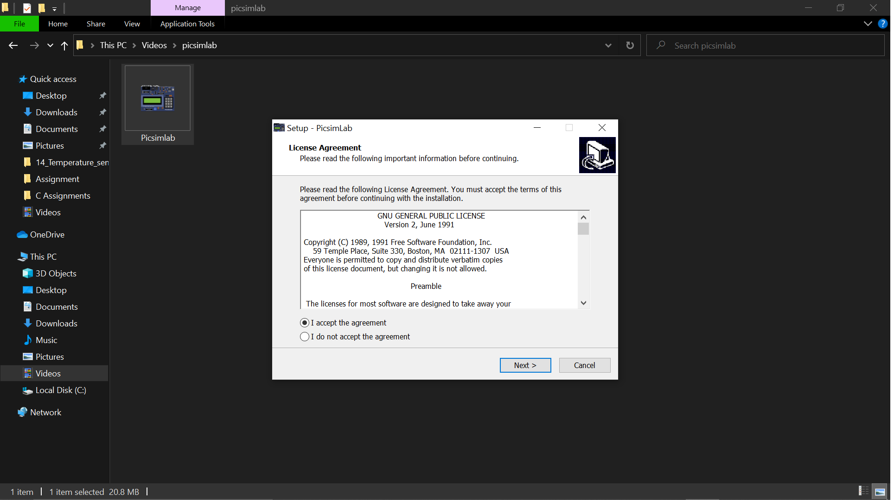
Arduino
Picsimlab installation
Select I accept the agreement and next.

Slide 10
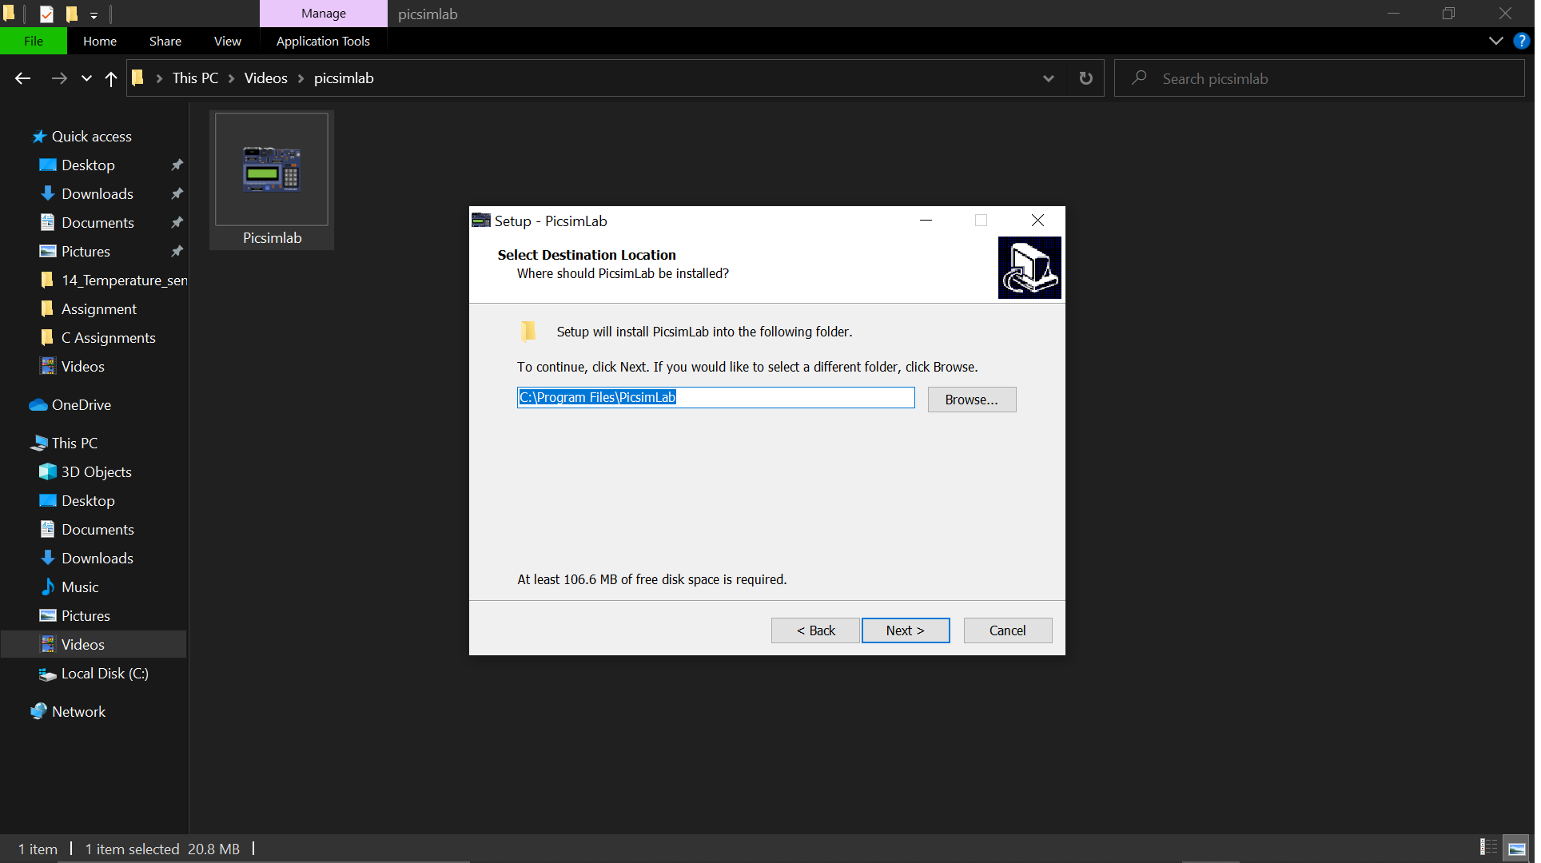
Arduino
Picsimlab installation
Select next

Slide 11
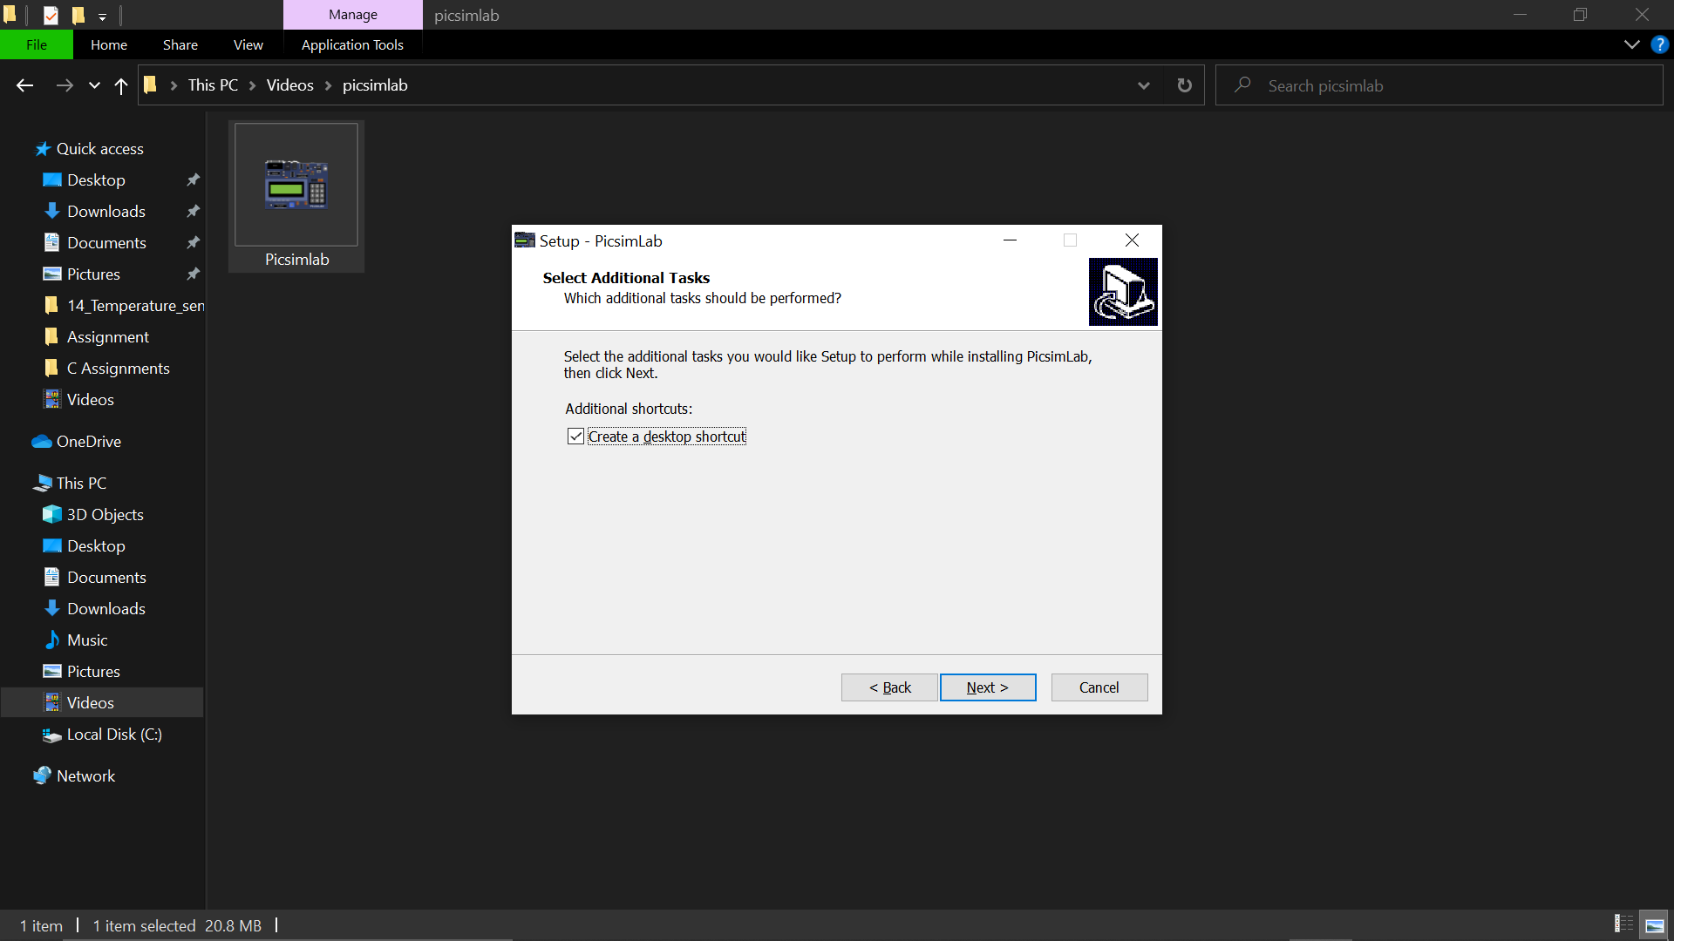
Arduino
Picsimlab installation
Select next

Slide 12
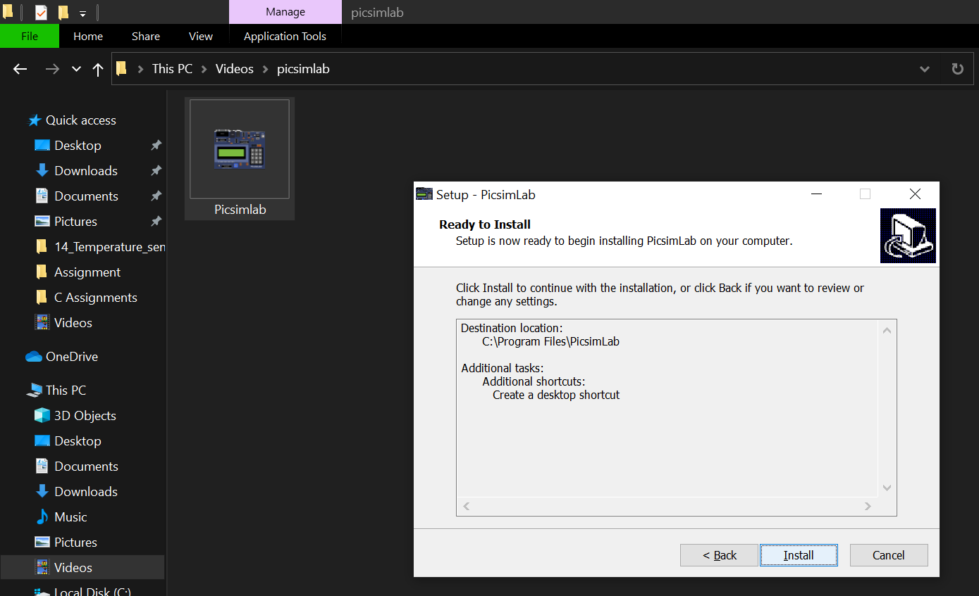
Arduino
Picsimlab installation
Select Install

Slide 13
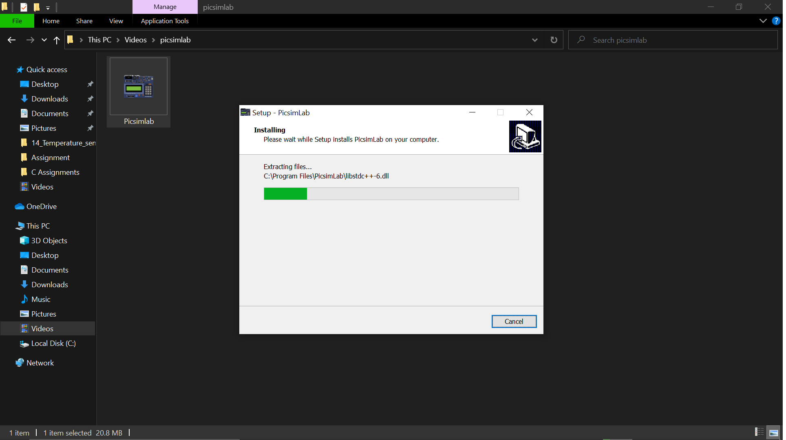
Arduino
Picsimlab installation
Intalling

Slide 14
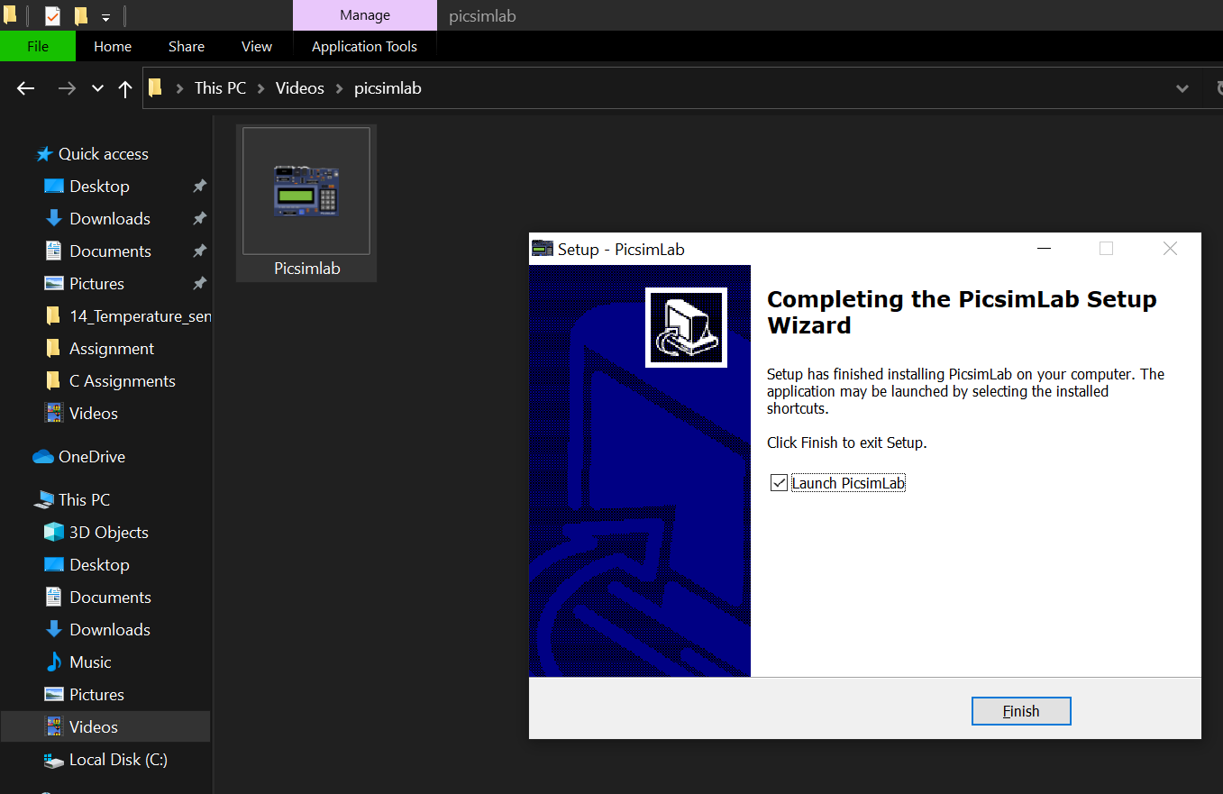
Arduino
Picsimlab installation
Select Finish

Slide 15
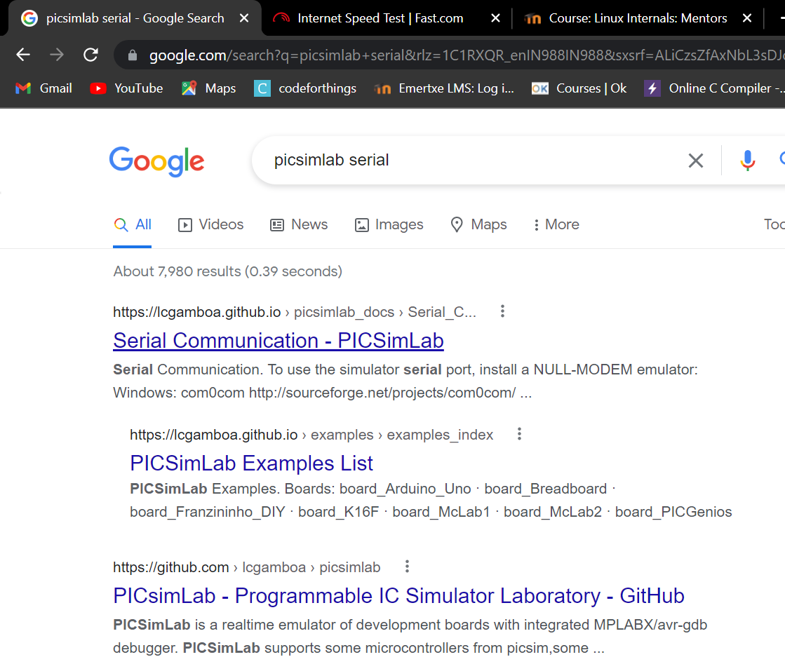
Arduino
Null modem emulator installation
Search for Picsimlab Serial and select the first link

Slide 16
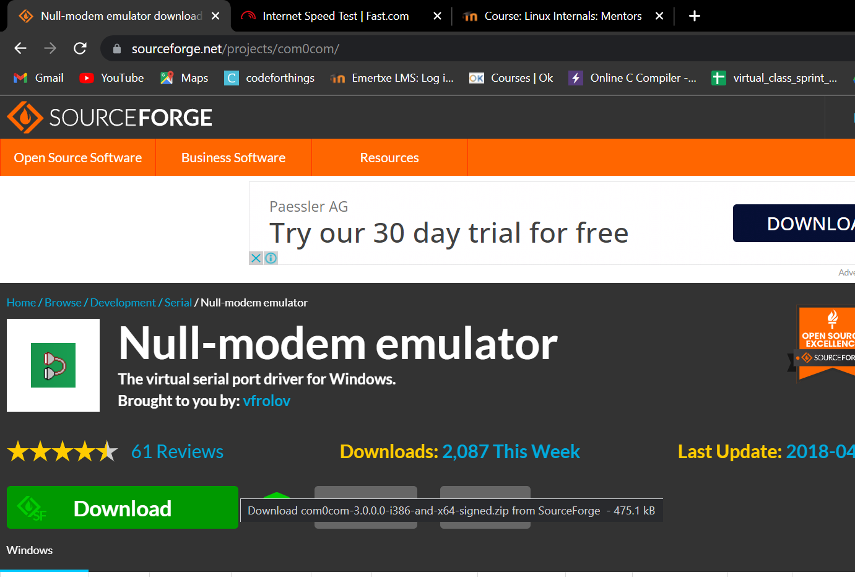
Arduino
Null modem emulator installation
Click on the
Download option

Slide 17
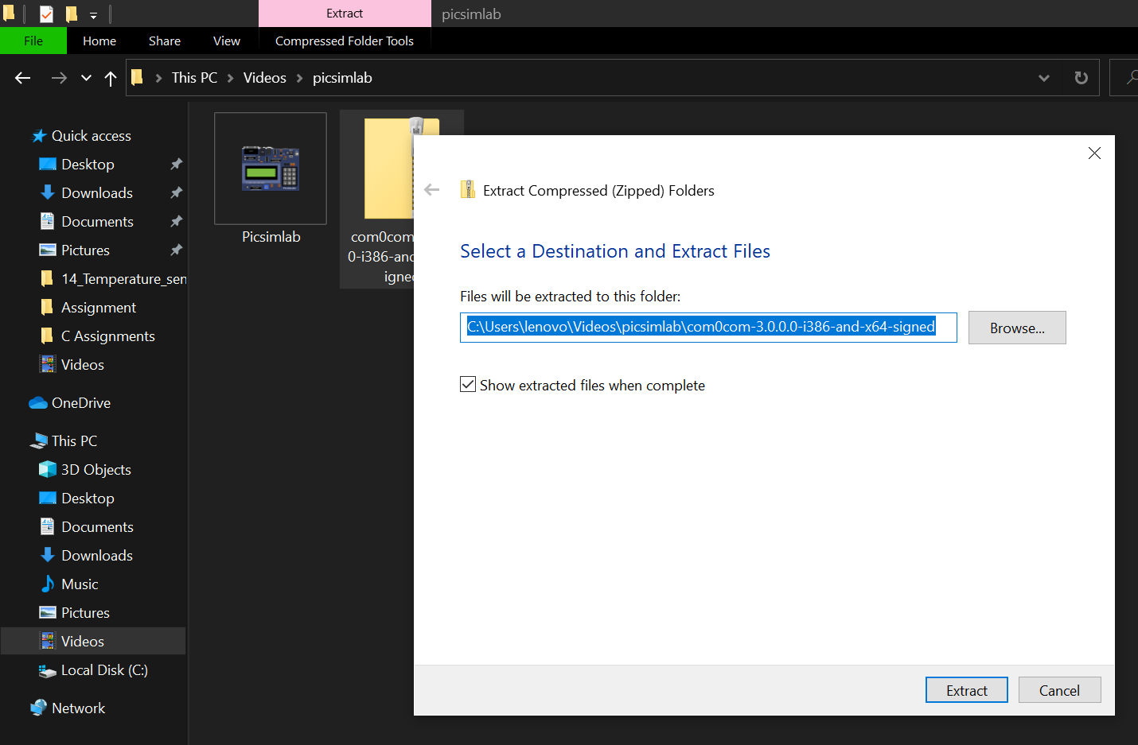
Arduino
Null modem emulator installation
Go to downloads
and search for dowloaded file
and extart the
contents .

Slide 18
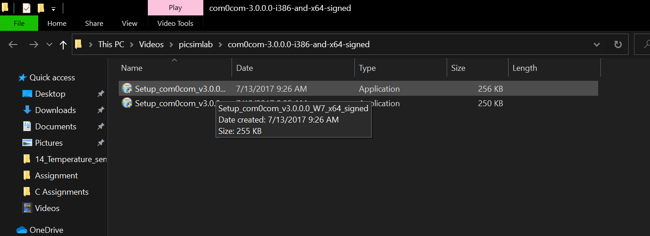
Arduino
Null modem emulator installation
Go to extracted
files and double
click on it to
start installation.

Slide 19
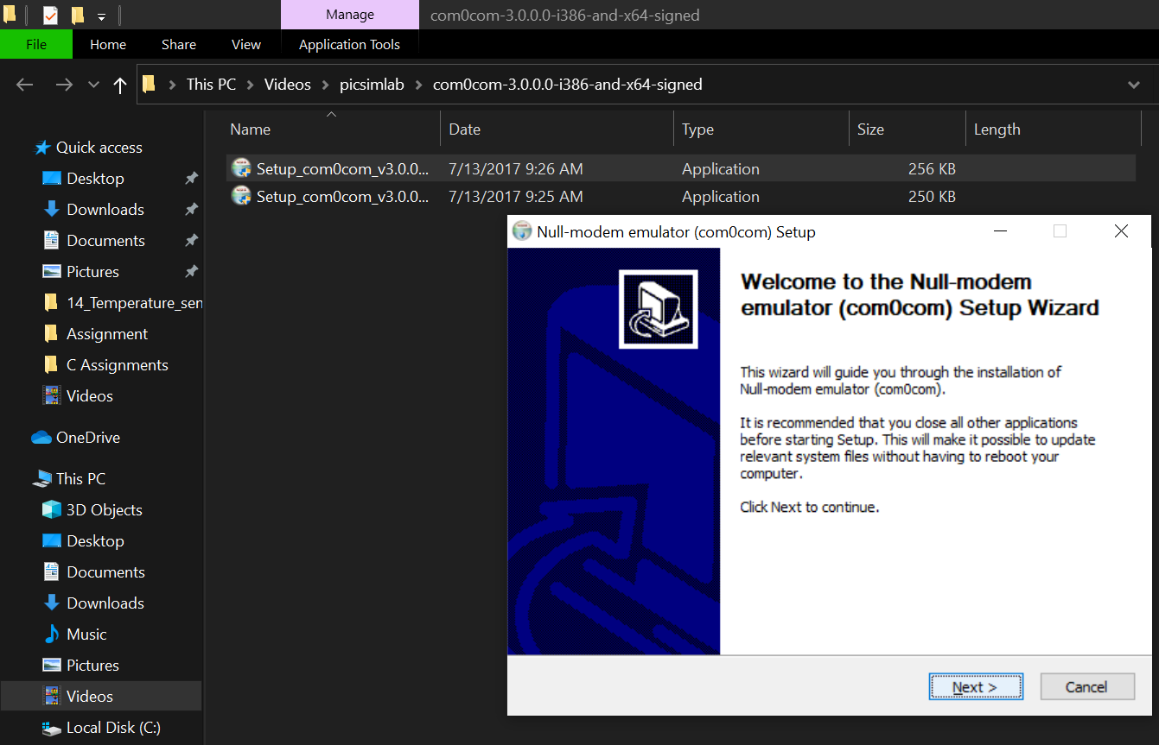
Arduino
Null modem emulator installation
Click Next

Slide 20
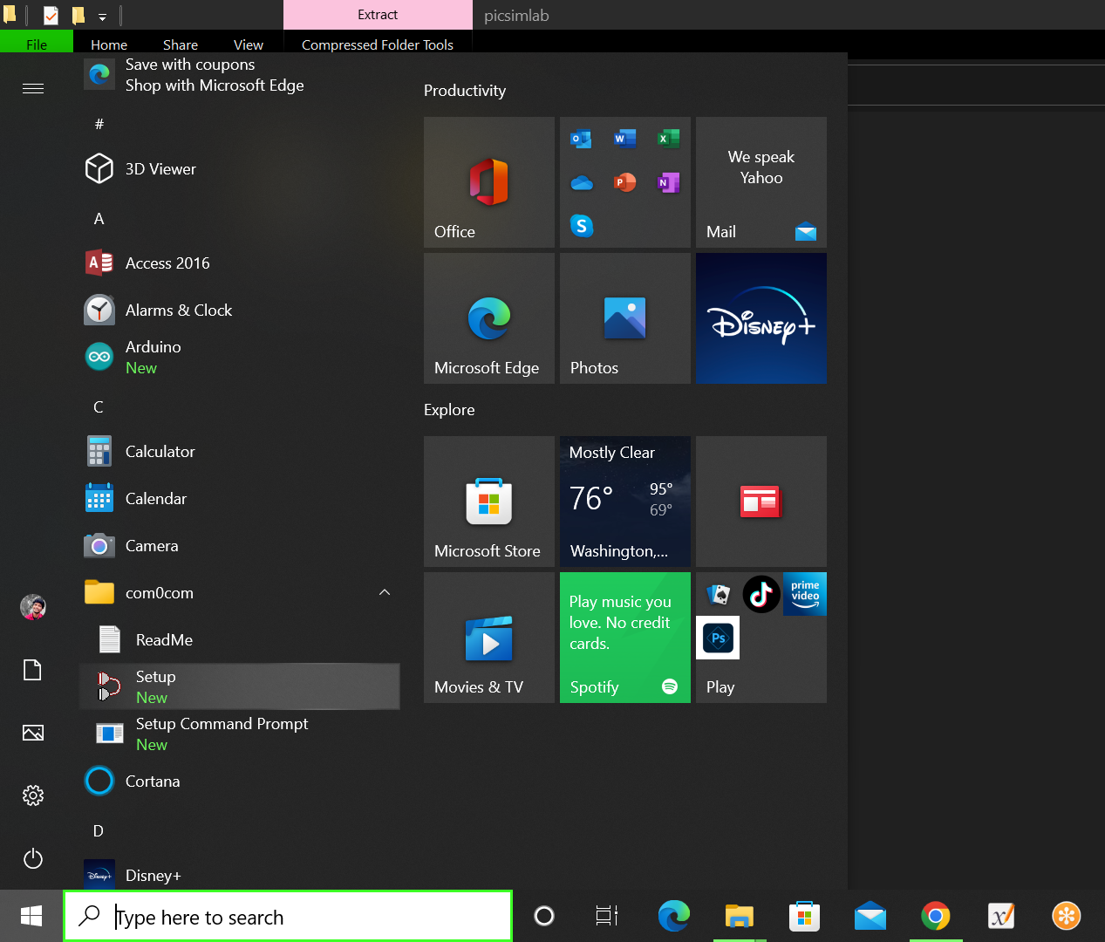
Arduino
Null modem emulator installation
Press the windows button and select the
setup option

Slide 21
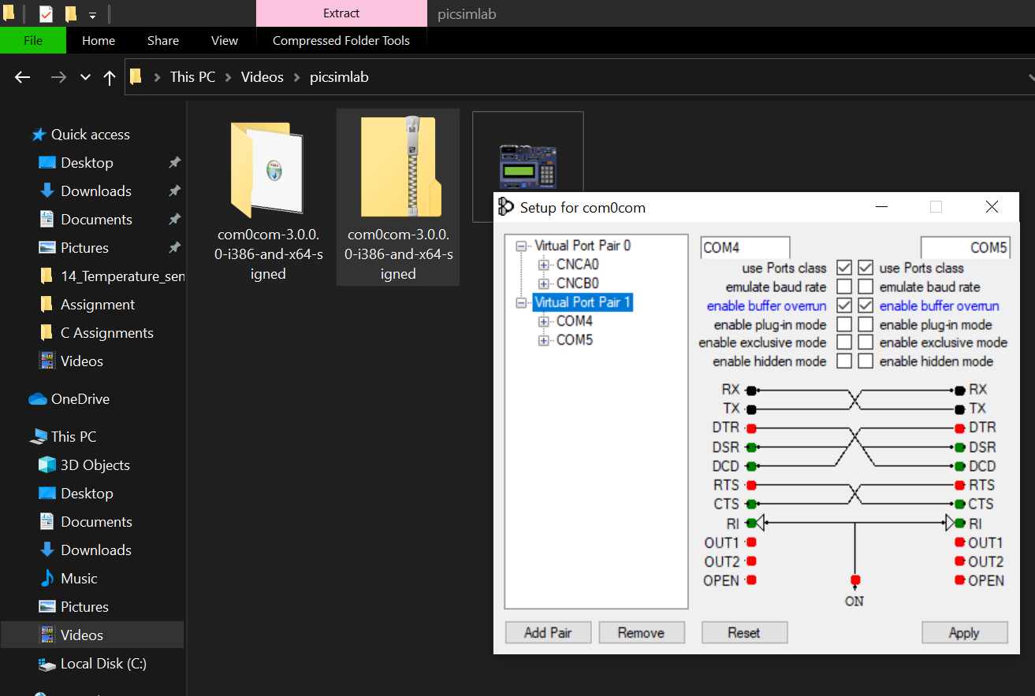
Arduino
Null modem emulator installation
Select Add Pair and give names COM4 ,COM5
and apply.

Slide 22
Thank You

